Slide 1
ANAC Global Committee
Information Sesion
July 17, 2025

Slide 2
Today’s Agenda
Introductions
History of the Global Committee
Recent Global Committee Activities
Global Committee Structure and Re-structure
Working Groups
Questions

Slide 3
GLOBAL COMMITTEE INFO SESSION | JULY 2025
Welcome
Our Global Committe Chairs
Ellen Schell, RN, PhD, FAAN worked in global health for over 20 years, serving as the International Programs Director for Global AIDS Interfaith Alliance (GAIA) and as a professor at UCSF. She is now retired and continues to contribute to the field of HIV as a member of ANAC and the chair of this committee.
Ellen Schell
Noriel Calaguas PhD, MSHSA, RN, ACRN is the Head of the Center for teaching and learning at Holy Angel University. He is a passionate champion for global health equity and decolonization. He is also the first global member to serve as an ANAC committee chair!
Noriel Calaguas

Slide 4
GLOBAL COMMITTEE INFO SESSION | JULY 2025
A Brief History of ANAC’s Global Committee
ANAC has long committed to global health and HIV nursing leadership
Our strategic plan includes a strong global engagement component
The Global Committee was formed to support that goal

Slide 5
GLOBAL COMMITTEE INFO SESSION | JULY 2025
ANAC at International AIDS Conference
Excellence in Global HIV Nursing Award
Joint policy statement on global HIV funding cuts
Drafting a JANAC piece on global HIV nursing leadership
Exploring partnerships (e.g., Ghanaian Diaspora Nursing Association)
Recent Global Activities

Slide 6
GLOBAL COMMITTEE INFO SESSION | JULY 2025
Re-structuring the Global Committee
Co-Chair
Co-Chair
Committee Members

Slide 7
ANAC GLOBAL COMMITTEE 2025
Co-Chairs
Working Group Leads
Working Groups
All
Members
Advocacy
Chapter
Formation
Program Development
Funding and Partnerships

Slide 8
GLOBAL COMMITTEE INFO SESSION | JULY 2025
Advocacy
Focus: Support advocacy and policy work
Sample Goal: Draft a policy brief on the PrEP Injectables

Slide 9
GLOBAL COMMITTEE INFO SESSION | JULY 2025
Chapter Formation
Focus: Build a framework for starting ANAC chapters globally
Sample Goal: Develop a "how to start a chapter" guide

Slide 10
GLOBAL COMMITTEE INFO SESSION | JULY 2025
Program Development
Focus: Create timely and culturally relevant education and training
Sample Goal: Plan a global webinar or virtual training

Slide 11
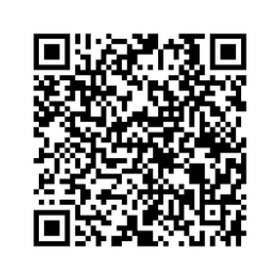
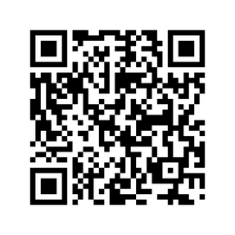
GLOBAL COMMITTEE INFO SESSION | JULY 2025
Apply to join a working group
Submit your application here
Work groups meet monthly, with the full committee meeting quarterly. Time commitment is flexible (~2-4 hours/month).
How to get involved
Join our whatsapp community
Stay up to date and connect with global members

Slide 12
GLOBAL COMMITTEE INFO SESSION | JULY 2025
Discussion

Slide 13
GLOBAL COMMITTEE INFO SESSION | JULY 2025
For questions, requests and anything else we can help you with, please email Mwikali at mwikali@anacnet.org
Thank you!

