Slide 1
Medicare and People Aging with HIV Part 2: Focus on Ryan White HIV AIDS Program (RWHAP)
Faculty:
Andrea Jackson, DrPH, MPH
John “JJ” Jackson, MA, NCC, LGPC
Liesl Lu, MS
Christine Luong, MPH
Moderator:
Sheila Tumilty, BSN, RN, ACRN
December 13, 2022

Slide 2
The Association of Nurses in AIDS Care (ANAC)
Mission: ANAC fosters the professional development of nurses and others involved in the delivery of health care for persons at risk for, living with and/or affected by the human immunodeficiency virus (HIV) and its comorbidities. ANAC promotes the health, welfare and rights of people living with HIV around the world.

Slide 3
Nursing Continuing Professional Development (NCPD)
ANAC will provide one contact hour of NCPD on completion of this activity.
To receive a certificate of completion, attendees must:
Be registered to attend
View today’s webinar presentation
Complete the online, post-activity evaluation. You will receive a link to the evaluation by email.
The deadline to claim contact hours is December 31, 2022.
ANAC is accredited as a provider of nursing continuing professional development by the American Nurses Credentialing Center’s Commission on Accreditation.
NCPD questions? Email Sheila@anacnet.org
Notes:
NCPD is the new term that the American Nurses Credentialing Center is using in place of CNE. ANAC is accredited as a provider of NCPD by the American Nurses Credentialing Center’s Commission on Accreditation. To receive contact hours, you will need to complete the post activity evaluation after today’s webinar. The link will be sent in a follow-up email.

Slide 4
Learning Outcomes
At the conclusion of today’s activity, participants will be able to:
Discuss the health status and mortality of people living with HIV (PLWH) who are aging and on Medicare
Discuss strategies to improve the care and outcomes of people aging with HIV
Describe the use of Ryan White funds to pay for select Medicare costs

Slide 5
Housekeeping
Please keep your lines muted during the webinar
Type questions in the “Question” pane of your dashboard
Q & A session at the end of the webinar

Slide 6
Faculty
Andrea Jackson, DrPH, MPH (she/her) Chief, Policy Development Branch HIV/AIDS Bureau Health Resources and Services Administration
John “JJ” Jackson, MA, NCC, LGPC (he/him)
Public Health Analyst, Division of State HIV/AIDS Programs
HIV/AIDS Bureau
Health Resources and Services Administration
Liesl Lu, MS (she/her)
Senior Technical Advisor, ACE TA Center
Senior Consultant, JSI
Christine Luong, MPH (she/her)
Research & Policy Associate, ACE TA Center
Consultant, JSI

Slide 7
Ryan White HIV/AIDS Program, Medicare and Aging Medicare and Aging with HIV Part 2: Focus on Ryan White HIV AIDS Program December 13, 2022
Andrea Jackson, DrPH, MPH
HIV/AIDS Bureau
Health Resources and Services Administration

Slide 8
HRSA’s HIV/AIDS Bureau Vision and Mission
Vision
Optimal HIV care and treatment for all to end the HIV epidemic in the U.S.
Mission
Provide leadership and resources to advance HIV care and treatment to improve health outcomes and reduce health disparities for people with HIV and affected communities.
Notes:
Dr. Cheever
Given the rapid changes in healthcare, and the Ending the HIV Epidemic in the U.S. initiative, along with the release of the National HIV/AIDS Strategy, we refreshed HAB’s Vision and Mission.
The update ensures that both our Mission and Vision are forward looking and acknowledges the ultimate goal of ending the HIV epidemic in the U.S. and what HAB needs to do to get there while continuing to provide the quality HIV care of the RWHAP that current and newly diagnosed people with HIV need.
We want to underscore that we wouldn’t be able to achieve our Vision and Mission without the support of all of you who are carrying out this important work each day.

Slide 9
HRSA’s Ryan White HIV/AIDS Program (RWHAP) Overview
Provides a comprehensive system of HIV primary medical care, medications, and essential support services for low-income people with HIV.
Funds grants to states, cities, counties, and local community-based organizations to improve health outcome and reduce HIV transmission.
Recipients determine service delivery and funding priorities based on local needs and planning process.
Provided services to more than 567,000 people in 2021—more than half of all people with diagnosed HIV in the United States.
89.7% of RWHAP clients receiving HIV medical care were virally suppressed in 2021, exceeding national average of 64.6%^{i}.
i. Centers for Disease Control and Prevention. Core indicators for monitoring the Ending the HIV Epidemic initiative (early release): National HIV Surveillance System data reported through December 2020; and pre-exposure prophylaxis (PrEP) data reported through September 2020. HIV Surveillance Data Tables [Table 5a] 2021;2(No. 2). http://www.cdc.gov/hiv/library/reports/surveillance-data-tables/vol-2-no-2/index.html. Published March 2021.

Slide 10
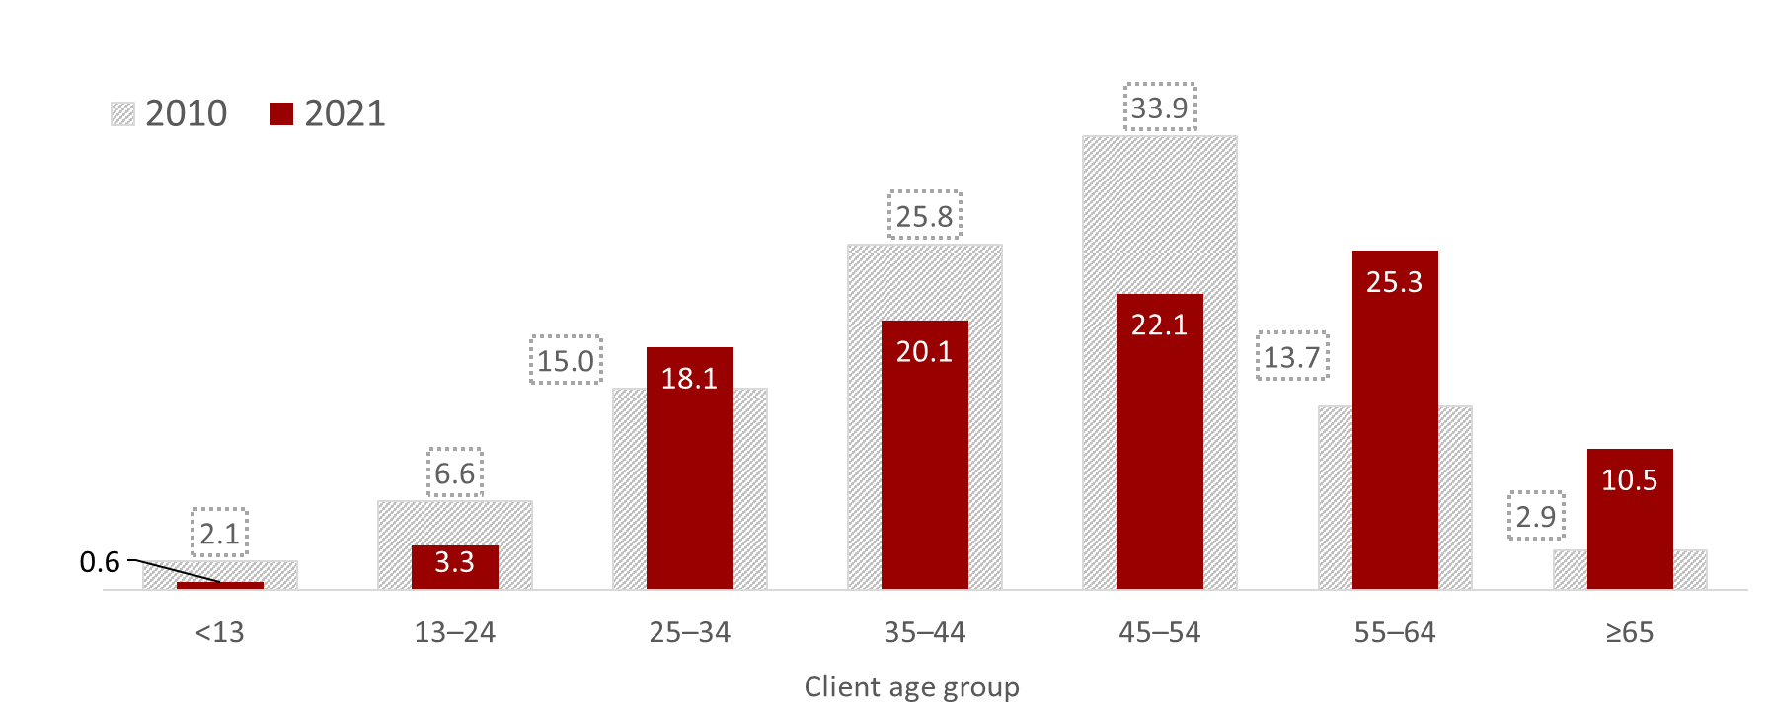
The RWHAP population is aging: from 2010 through 2021, the percentage of clients aged 55 years and older grew by 19 percentage points
Percentage of all RWHAP clients
⇧ 19.2 percentage points combined
Source: HRSA. Ryan White HIV/AIDS Program Data Report (RSR) 2021. Does not include AIDS Drug Assistance Program data.
Notes:
Here we can see some of the shifts in the age distribution of clients in 2010 and 2021.
To orient you to the image quickly, the hashed or gray bars are 2010 percentages and the red bars are 2021 percentages of people in each age group. As you can see, clients aged 55-64 increased 11.6 percentage points and those aged 65 and older increased 7.6 percentage points, for a total of 19.2 percentage point increase among the population of people 55 and older.

Slide 11
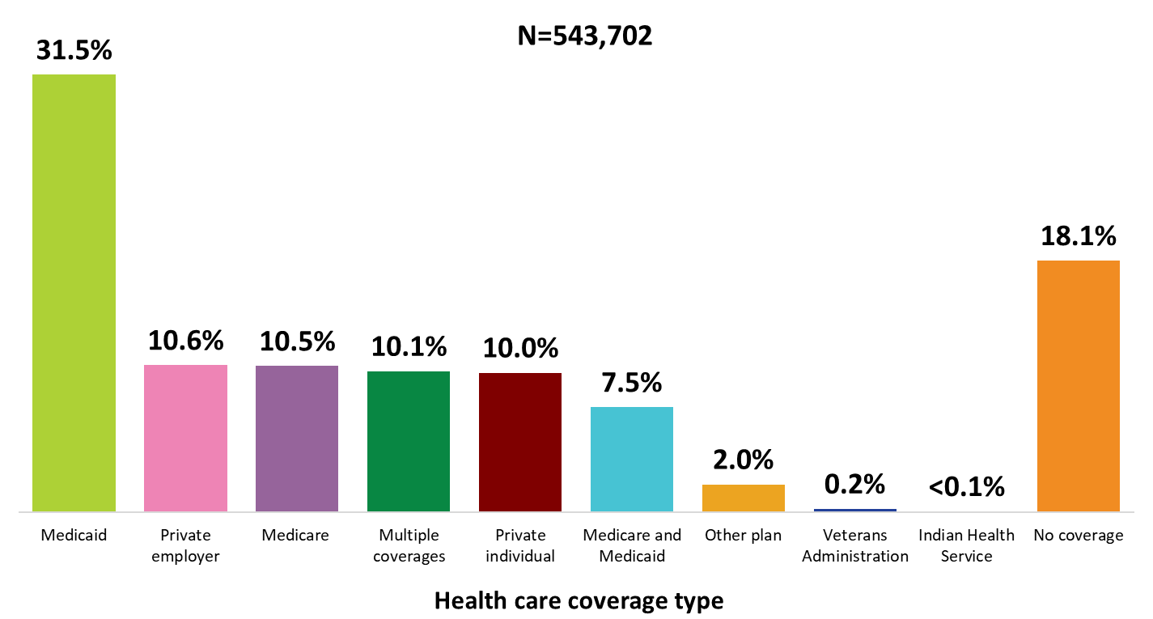
Clients Served by the Ryan White HIV/AIDS Program, by Health Care Coverage, 2021—United States and 3 Territoriesª
ª Guam, Puerto Rico, and the U.S. Virgin Islands.
Source: HRSA. Ryan White HIV/AIDS Program Data Report (RSR) 2021. Does not include AIDS Drug Assistance Program data.
Notes:
In 2021, 81.9% of RWHAP clients had some form of health care coverage. Of the 543,702 clients with reported health care coverage information, 31.5% were covered by Medicaid, 10.6% had private employer coverage, 10.5% were covered by Medicare, 10.1% had multiple forms of coverage, 10.0% had private individual coverage, and 7.5% had both Medicare and Medicaid dual coverage. Nearly one-fifth (18.1%) of RWHAP clients had no health care coverage in 2021.
Multiple coverage includes any combination of coverage types except for the Medicare and Medicaid dual enrollment category, which is displayed separately.
The three territories include Guam, Puerto Rico, and the U.S. Virgin Islands.

Slide 12
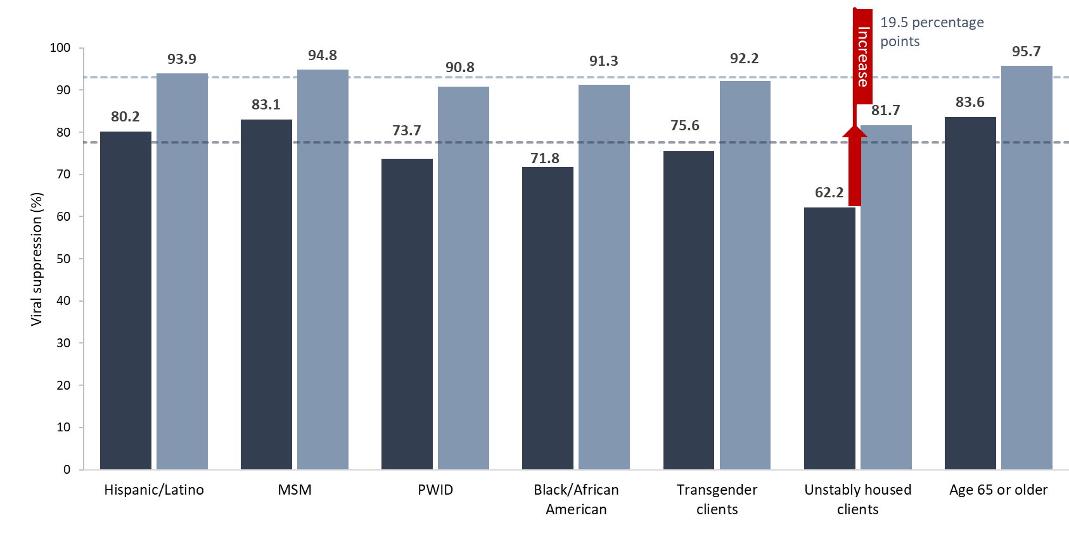
Viral Suppression among Older Adults Aged 50 Years and Older Served by the Ryan White HIV/AIDS Program, 2010 and 2021
RWHAP older adults overall, 2021 (93.1%)
RWHAP older adults overall, 2010 (77.6%)
2010
2021
Source: HRSA. Ryan White HIV/AIDS Program Data Report (RSR) 2021. Does not include AIDS Drug Assistance Program data.
Notes:
Viral suppression for all RWHAP clients aged 50 years and older overall in 2010 was 77.6% and was 93.1% in 2021. This upward trend in viral suppression occurred across all key populations of clients aged 50 years and older, with clients aged 65 years or older as having the highest viral suppression rates of 95.7% in 2021.
However, it is important to note that challenges remain in achieving viral suppression for certain populations. Most notably, older adults with unstable housing had a 19.5 percentage point increase from 2010 to 2021, but the percentage in 2021 was still remarkably lower than the average among all people aged 50 and older, at 81.7%.
Viral suppression among older adults aged 50 years and older can be found in table 14b

Slide 13
Ryan White HIV/AIDS Program and Medicare
A growing number of RWHAP clients are aging into Medicare (in addition to significant number of RWHAP clients who qualify for Medicare based on disability).
RWHAP funds may be used to pay for Medicare premiums and cost sharing associated with Medicare Parts B, C, and D coverage when doing so is determined to be cost effective and coverage includes:
Outpatient/ambulatory health services (Medicare Part B)
Prescription drug coverage (Medicare Part D) that includes at least one drug in each class of core antiretroviral therapeutics
See HRSA HAB PCN #18-01 Clarifications Regarding the Use of Ryan White HIV/AIDS Program Funds for Health Care Coverage Premium and Cost Sharing Assistance for additional information regarding the use of RWHAP funds for Medicare costs.
The RWHAP, as the payor of last resort, will continue to fund RWHAP services not covered, or partially covered, by public or private health care coverage.
Notes:
As mentioned, the demographics of clients served in the RWHAP are shifting as more clients are aging with HIV, and thus aging into Medicare (in addition to those who qualify based on disability).
Ensuring continuous access to HIV medications and medical care is essential for people with HIV, and therefore RWHAP funds can be used to help eligible Medicare beneficiaries with health coverage expenses when doing so is determined to be cost effective. However, it is important to note that RWHAP policies on the types of assistance provided for Medicare beneficiaries vary considerably; it is important for RWHAP recipients to understand availability of state and local resources to offset Medicare premium and cost sharing. More information regarding the use of RWHAP funds for Medicare can be found in HRSA HAB PCN #18-01 Clarifications Regarding the Use of Ryan White HIV/AIDS Program Funds for Health Care Coverage Premium and Cost Sharing Assistance.
The RWHAP, as the payor of last resort will continue to fund RWHAP services not covered, or partially covered, by public or private health care coverage.

Slide 14
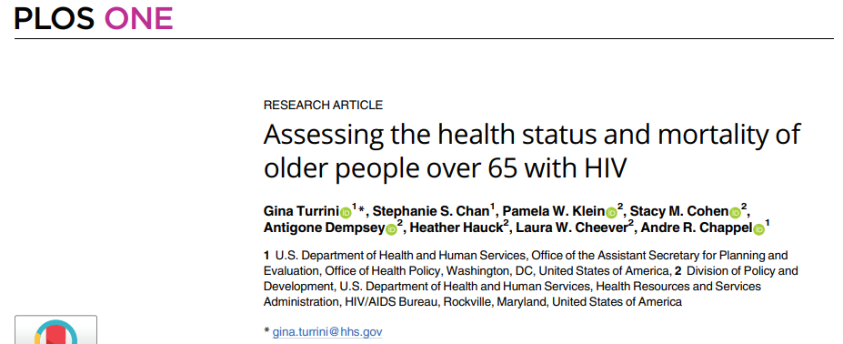
Assessing the health status and mortality of older people over 65 with HIV: Overview
In 2020, HAB and HHS Office of the Assistant Secretary for Planning and Evaluation (ASPE) examined the health status and mortality of Medicare beneficiaries with HIV compared to Medicare beneficiaries without an HIV diagnosis
Citation: Turrini G, Chan SS, Klein PW, Cohen SM, Dempsey A, Hauck H, et al. (2020) Assessing the health status and mortality of older people over 65 with HIV. PLoS ONE 15(11): e0241833. https://doi.org/10.1371/journal.pone.0241833
Notes:
In 2020, HAB and the HHS Office of the Assistant Secretary for Planning and Evaluation (ASPE) examined the health status and mortality of Medicare beneficiaries with HIV compared to Medicare beneficiaries without an HIV diagnosis. The results of this analysis were published in a special HRSA HIV/AIDS Bureau collection in the PLoS network of journals.
Optional data source/methods info:
This analysis used data from the Medicare Master Beneficiary Summary File for the time period 2011-2016 to compare those who did and did not have an HIV diagnosis on record.

Slide 15
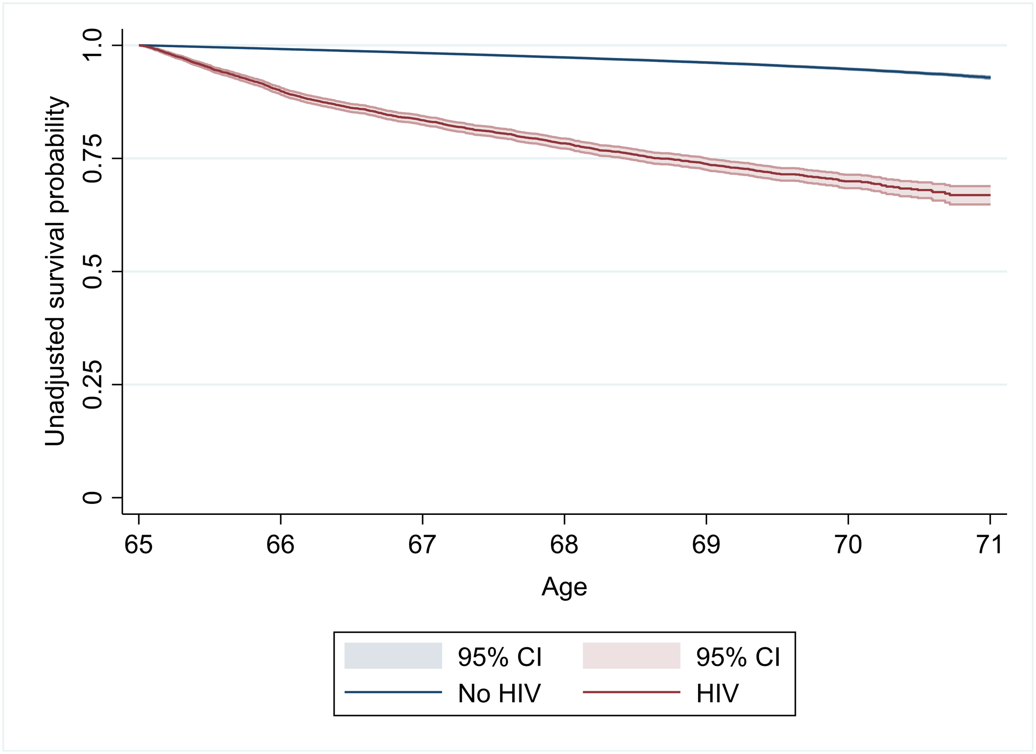
Assessing the health status and mortality of older people over 65 with HIV: Findings
Compared to Medicare beneficiaries without an HIV diagnosis:
Medicare beneficiaries with HIV had a significantly higher mortality rate
Medicare beneficiaries with HIV were more likely to receive a diagnosis for:
depression
chronic kidney disease
COPD
osteoporosis
hypertension
ischemic heart disease
diabetes
chronic hepatitis
end-stage liver disease
lung cancer
colorectal cancer
Citation: Turrini G, Chan SS, Klein PW, Cohen SM, Dempsey A, Hauck H, et al. (2020) Assessing the health status and mortality of older people over 65 with HIV. PLoS ONE 15(11): e0241833. https://doi.org/10.1371/journal.pone.0241833
Notes:
Compared to Medicare beneficiaries without an HIV diagnosis, Medicare beneficiaries with HIV had a significantly higher mortality rate.
Also, Medicare beneficiaries were more likely to receive a diagnosis for many chronic comorbid conditions, listed here on this slide.

Slide 16
Assessing the health status and mortality of older people over 65 with HIV: Implications
Clinicians caring for older people with HIV may not have the same level of experience with caring for older adults as specialists in gerontology or geriatrics
Community partners and providers serving people with HIV can plan for an aging population including:
Training providers on the intersecting issues of aging and HIV, particularly multi-morbidity, polypharmacy, and the need for personalized care and maximizing functional capacity;
Coordination and integration of services, including HIV and geriatric services; and
Provider focus on prevention, screening, and treatment for other conditions for which older people with HIV are at higher risk
ASPE and HAB are conducting a follow-up analysis to examine health care use and costs among older Medicare beneficiaries with and with HIV
Citation: Turrini G, Chan SS, Klein PW, Cohen SM, Dempsey A, Hauck H, et al. (2020) Assessing the health status and mortality of older people over 65 with HIV. PLoS ONE 15(11): e0241833. https://doi.org/10.1371/journal.pone.0241833
Notes:
Clinicians caring for older people with HIV may not have the same level of experience with caring for older adults as specialists in gerontology or geriatrics.
Community partners and providers serving people with HIV can plan for an aging population in many ways including:
Training providers on the intersecting issues of aging and HIV, particularly multi-morbidity, polypharmacy, and maximizing functional capacity,
Coordination and integration of services, including HIV and geriatric services, and
Provider focus on prevention, screening, and treatment for other conditions for which older people with HIV are at higher risk
The RWHAP provides resources to support community partners and providers in many of these efforts. Additionally, ASPE and HAB are currently conducting a follow-up analysis to examine health care use and costs among older Medicare beneficiaries with and without HIV.

Slide 17
Two Reference Guides: Optimizing HIV Care for People Aging With HIV
Putting Together the Best Healthcare Team
Incorporating New Elements of Care
https://hab.hrsa.gov/clinical-quality-management/clinical-care-guidelines-and-resources
Notes:
In September 2020, a collaboration with several subject matter experts including infectious disease medical providers and researchers, and a geriatrician led to the compilation of a comprehensive list of clinical (health) and psychosocial needs released in two aging reference guides. These guides were created to assist RWHAP providers in addressing the issues and optimizing care for people aging with HIV.
One guide subtitled: Incorporating New Elements of Care focuses on screening tools available to providers that could improve the assessment of geriatric syndromes, cognitive and functional impairment, and social challenges.
The other guide subtitled: Putting Together the Best Healthcare Team focuses on how provider organizations can best utilize staff to support the assessments, care and treatment of people aging with HIV in the absence of a geriatrician or individuals with specific geriatric training.

Slide 18
National HIV Curriculum HIV in Older Adults Module
An AIDS Education and Training Center (AETC) Program – funded by HRSA HAB
Offers free online continuing education for novice-to-expert health care professionals, students, and faculty
Module devoted to HIV in older adults
Free Continuing Education (CE) for social work
www.hiv.uw.edu
Notes:
HRSA's AIDS Education and Training Center (AETC) Program supports national HIV priorities by building clinician and care team capacity, and expertise along the HIV care continuum.
In August 2018, the National HIV Curriculum (NHC) – an AETC program led by the University of Washington and funded by HRSA – was launched.
NHC is a free educational website that provides ongoing, up-to-date information needed to meet the core competency knowledge for HIV prevention, screening, diagnosis, and ongoing treatment and care to healthcare providers in the United States.
The curriculum is structured around core competencies identified by a multidisciplinary panel of expert HIV clinicians and educators from the AETC network.
There is a Key Populations module that is intended for any medical provider involved in the care of key populations of persons with HIV – including a module titled: HIV in Older Adults.
The module’s learning objectives includes a discussion on common comorbidities (e.g. frailty, neurocognitive disorders) of people w/HIV who are 50 years of age and older, and a summary of cognitive and functional changes that may interfere w/adherence to care.
The site was last updated in May 2020 and free continuing education hours for social workers are offered through this site.
https://www.hiv.uw.edu/go/key-populations/hiv-older-patients/core-concept/all

Slide 19
SPNS Emerging Strategies to Improve Outcomes for People Aging with HIV (08/01/2022 - 07/30/2025)
Purpose: Strengthen the evidence base for clinical and psychosocial services that improve the lives and health outcomes of people with HIV who are aging.
Implement emerging strategies that comprehensively screen and manage comorbidities, geriatric conditions, behavioral health, and psychosocial needs of people 50 years and older with HIV;
Assess the uptake and integration of emerging strategies;
Understand implementation processes including assessing specific implementation strategies;
Understand and document broader contextual factors affecting implementation;
Evaluate the impact of the emerging strategies; and
Document and disseminate emerging strategies.
Notes:
In August 2022, HAB began a three-year project, the SPNS Emerging Strategies to Improve Outcomes for People Aging with HIV initiative. The overall purpose of the project is to strengthen the evidence base for clinical and psychosocial services that improve the lives and health outcomes of people with HIV who are aging. The initiative has three components, a Capacity provider to organize, offer technical assistance and support dissemination; 10 demonstration sites to implement emerging interventions, and an Evaluation Provider to coordinate all evaluation efforts. Overall, the project seeks to implement emerging interventions, assess the uptake, understand the implementation process, document successes and challenges, evaluate the impact, and finally disseminate best practices, tools and resources of these emerging strategies.

Slide 20
Access, Care, and Engagement (ACE) TA Center
John “JJ” Jackson, MA, NCC, LGPC
Division of State HIV/AIDS Programs | HIV/AIDS Bureau | Health Resources and Services Administration

Slide 21
Access, Care, and Engagement (ACE) TA Center
The Access, Care, and Engagement Technical Assistance (ACE TA) Center builds the capacity of the Ryan White HIV/AIDS Program (RWHAP) community to navigate the changing health care landscape and help people with HIV to access and use their health coverage to improve health outcomes. Many RWHAP clients are eligible for health coverage options, including Medicare, Medicaid, and Marketplace plans.
The ACE TA Center provides practical tools and resources to support engagement, education, enrollment, and renewal activities.
HRSA Contact: John “JJ” Jackson (JJackson1@hrsa.gov)

Slide 22
Aging with HIV and ACE TA Center Work
Needs Assessment Development
National HIV/AIDS Strategy Federal Implementation Plan for 2022-2025

Slide 23
Upcoming Webinars
January 17, 2:00-3:30 pm ET - Part I: The Basics of Medicare for Ryan White HIV/AIDS Program (RWHAP) Clients
January 31, 2:00-3:30 pm ET - Part II: Medicare Enrollment and Coverage for Ryan White HIV/AIDS Program (RWHAP) Clients
February 14, 2:00-3:00 pm ET - Medicaid 101 for Ryan White HIV/AIDS Program Recipients and Providers
February 28, 2:00-3:00 pm ET - Medicare-Medicaid Dual Eligibility for Ryan White HIV/AIDS Program Clients

Slide 24
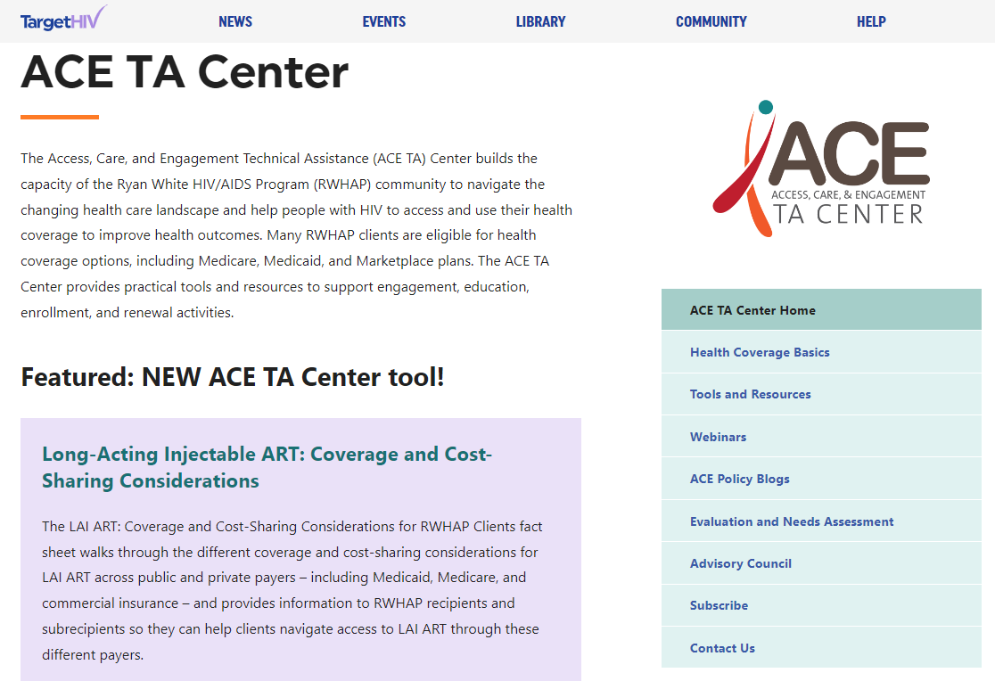
FIND US AT:
targethiv.org/ace

Slide 25
Thank you!
targethiv.org/ace
Sign up for our mailing list, download
tools and resources, and more.
Contact Us
acetacenter@jsi.com

Slide 26
Contact Information
Connect with HRSA
Andrea Jackson, DrPH, MPH
Division of Policy and Data
HIV/AIDS Bureau (HAB)
Health Resources and Services Administration (HRSA)
Email: AJackson1@hrsa.gov
John “JJ” Jackson MA, NCC, LGPC
Division of State HIV/AIDS Programs
HIV/AIDS Bureau (HAB)
Health Resources and Services Administration (HRSA)
Email: JJackson1@hrsa.gov
Learn more about our agency at:
www.HRSA.gov
Sign up for the HRSA eNews
FOLLOW US:
26
Notes:
That concludes the updates from HRSA. Thank you!

Slide 27
Medicare Enrollment and Coverage for RWHAP Clients
Liesl Lu, MS
Christine Luong, MPH
Presentation for ANAC
December 13, 2022

Slide 28
Today’s presenters
Liesl Lu
Christine Luong
Senior Technical Advisor,
ACE TA Center
Senior Consultant, JSI
Research & Policy Associate, ACE TA Center
Consultant, JSI

Slide 29
Enrollment Challenges
Best Practices and Enrollment Support
Financial
Help

Slide 30
Best Practices and Enrollment Support

Slide 31
Best practices to support Medicare enrollment
Ensure continuity of coverage
Actively enroll
Avoid penalties
Provide one-on-one enrollment support

Slide 32
BEST PRACTICE #1: Ensure continuity of coverage
Confirm with clients that their current providers accept Medicare: medicare.gov/care-compare
Help clients compare Medicare drug plans in their area and choose one that covers their HIV medications and other non-HIV medications: medicare.gov/plan-compare/
Reminder: The RWHAP, including ADAP, may help pay for Medicare premiums, deductibles, and copayments.

Slide 33
BEST PRACTICE #2: Actively enroll
For clients who choose:
Original Medicare (Parts A and B), enroll through Social Security
Medicare Advantage, Medicare Part D (Rx Drug Plan), or Medigap, enroll through Medicare.gov
Only a small subset of people are automatically enrolled in Medicare:
People already receiving Social Security retirement benefits
People receiving 24+ months of Social Security Disability Insurance (SSDI) benefits
People with ESRD or ALS

Slide 34
BEST PRACTICE #3: Avoid penalties
Help clients enroll as soon as they are eligible to avoid late enrollment penalties and minimize gaps in coverage.
Create EHR reminders or ask medical case managers to flag clients who:
Are approaching their 65th birthday
Will be receiving their 25th month of SSDI benefits

Slide 35
BEST PRACTICE #4: Provide one-on-one enrollment support
Establish a relationship with your local State Health Insurance Assistance Program (SHIP): shiphelp.org
Refer clients to SHIP for external Medicare enrollment support
Support RWHAP staff to become trained SHIP counselors in order to build in-house enrollment capacity

Slide 36
State Health Insurance Assistance Programs (SHIP)
State-based programs that provide local and objective insurance counseling and assistance to Medicare-eligible individuals, their families, and caregivers.
Review health or drug plan options
Explore financial assistance options
Explain how Medicare works with other types of health coverage
Help with complex issues such as dual eligibility for Medicaid and Medicare.
Find your local SHIP: shiphelp.org/about-medicare/regional-ship-location

Slide 37
Train RWHAP staff as SHIP counselors
RWHAP and ADAP program staff are ideal SHIP counselors.
They understand the eligibility requirements for both programs, the coverage needs of people with HIV, and state-specific programs.
Training programs and certification requirements may vary by state.
Individual SHIP counselors must be associated with a SHIP-certified organization.
Contact your state health department for more information.

Slide 38
Enrollment Challenges

Slide 39
ENROLLMENT CHALLENGE #1: Deferring enrollment without incurring penalties
Make sure RWHAP clients enroll in Medicare Part A, B, and/or D when they are first eligible, unless they have a legitimate reason to defer, such as:
Client is still working and has employer-sponsored insurance.
Client is eligible for a Medicare Savings Program.
Client has other creditable prescription drug coverage.
Client qualifies for the federal Extra Help program.

Slide 40
ENROLLMENT CHALLENGE #1: Deferring enrollment without incurring penalties
Medicare Part A Penalty
For people who don’t qualify for premium-free Part A, pay an additional 10% on their monthly premium for twice the number of years they were eligible.
Can be avoided if they have employer-sponsored coverage.
Medicare Part B Penalty
Pay an additional 10% for each year they were eligible (a lifetime penalty!)
Can be avoided if they have employer-sponsored coverage or qualify for a Medicare Savings Program.
If incurred prior to age 65, can be reset to $0 during IEP at age 65.

Slide 41
ENROLLMENT CHALLENGE #1: Deferring enrollment without incurring penalties
Medicare Part D Penalty
Pay an additional 1% of a national benchmark amount for each full, uncovered month a person did not have Part D or other creditable coverage.
This is also a lifetime penalty!
Generally significantly smaller than Part A or B penalties and much easier to resolve
Can be avoided by having creditable prescription drug coverage or qualifying for the Extra Help program

Slide 42
ENROLLMENT CHALLENGE #2: Deferring enrollment if keeping employer coverage
If a client plans to keep employer-sponsored coverage, make sure they talk to their employer’s Human Resources department first before deferring Medicare enrollment.
Individuals on employer-sponsored insurance (through their own or a spouse's employer) can generally enroll into Part A and keep their employer-sponsored plan.
A retiree plan or COBRA coverage is NOT considered qualifying coverage, and does not exempt an individual from the Part B late enrollment penalty.

Slide 43
ENROLLMENT CHALLENGE #3: Transitioning from Marketplace to Medicare
Enroll in Medicare when first eligible during Initial Enrollment Period (IEP)
If a client missed the IEP, enroll through the next GEP or equitable relief
Marketplace Termination:
Marketplace coverage usually does NOT terminate automatically.
Clients will lose APTCs if they are:
Eligible for premium-free Medicare Part A and still enrolled in Marketplace coverage
Enrolled in Medicare Part A with a premium
Clients can keep APTCs if they are eligible for but not enrolled in Medicare Part A with a premium.

Slide 44
ENROLLMENT CHALLENGE #3: Transitioning from Marketplace to Medicare
Encourage clients to do the following:
Check mail frequently for notices from the Marketplace or Medicare.
Be aware of the start dates for their Medicare Part A, B, and D coverage before terminating Marketplace coverage, in order to avoid any coverage gaps.
Contact the Social Security office if they encounter any enrollment issues.

Slide 45
Financial Help

Slide 46
Tips for helping clients use RWHAP with Medicare coverage
Remind clients that ADAP is always the payor of last resort.
For clients with Medicare Advantage or Medicare Part D deductibles, clients should direct pharmacies to bill their Medicare, not ADAP, in order to meet their deductible requirements.
Premium amounts can change throughout the year.
To avoid coverage termination or accruing past due amounts, keep an eye out for notices in the mail about changes to their premiums so that RWHAP can help clients pay their premiums in full and on time.

Slide 47
Medicare Savings Programs (MSP) for dually eligible clients
Federally-funded, state-administered programs for low-income beneficiaries that help pay for some or all of the enrollee’s Medicare premiums and out-of-pocket expenses.
Some dually eligible people will qualify.
4 types of MSPs (varies by state):
Qualified Medicare Beneficiary (QMB)
Specified Low-Income Medicare Beneficiary (SLMB)
Qualifying Individual (QI)
Qualified Disabled and Working Individuals (QDWI)

Slide 48
Extra Help Program: Part D Low-Income Subsidy (LIS)
A federal program that helps individuals pay for some or most of the out-of-pocket costs associated with Medicare Part D prescription drug coverage.
Individuals can qualify for either full or partial assistance depending on their income and assets.
Enrolling in the Extra Help program will eliminate any Medicare Part D late enrollment penalties that an individual may have incurred.

Slide 49
Other sources of financial help
State Pharmaceutical Assistance Programs (SPAPs) can help eligible people pay for their prescription drugs based on financial need, age, or medical condition.
Some major drug manufacturers offer Patient Assistance Programs (PAPs), which provide free or low-cost medications for people with Medicare drug coverage who meet certain requirements.
Programs of All-Inclusive Care for the Elderly (PACE) are state-administered programs for dually eligible individuals who require a nursing home-level of care.

Slide 50
Other sources of financial help
Low-Income Newly Eligible Transition (LINET) program provides temporary, sometimes retroactive, Part D coverage for those who were on Medicaid and are waiting for Part D to start.
Other state and local resources, such as financial assistance programs through clinics, hospitals, and FQHCs.

Slide 51
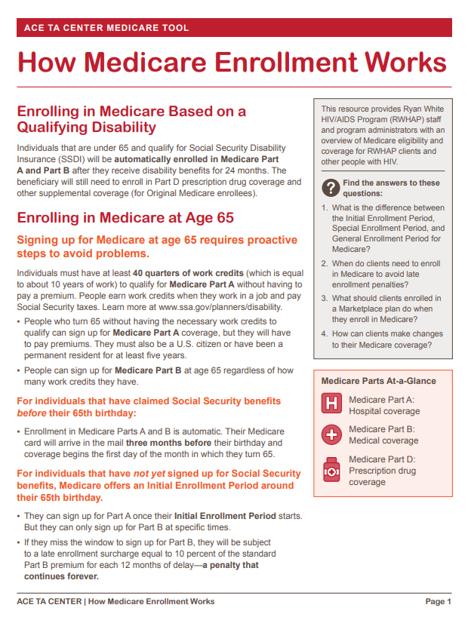
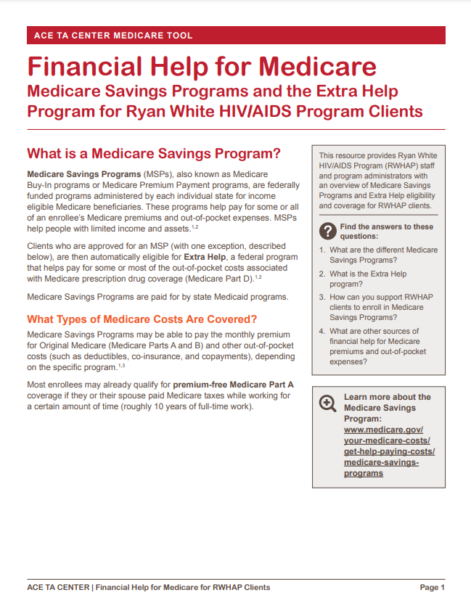
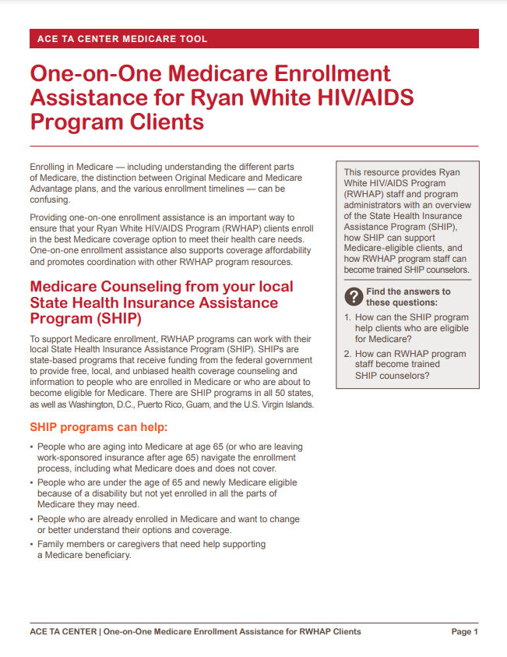
ACE TA Center Medicare Resources
targethiv.org/ace/medicare

Slide 52
Thank you.
Sign up for our mailing list, download tools and resources, and more: targethiv.org/ace
Contact us at acetacenter@jsi.com

Slide 53
Questions and Answers
Please submit all questions through the Chat box
and we will do our best to address them

Slide 54
ANAC’s HIV and Aging Learning Modules
ANAC developed a series of learning modules to educate RNs, APRNs, LPNs, CNAs and other healthcare providers working with aging PLWH. The modules provide a standardized body of knowledge and aim to improve the quality of care for people living, aging and thriving with HIV.
The current modules available now are:
HIV Foundations
Brain Health, Cognition and Mental Health
Chronic Co-Occurring Conditions
Creating an Inclusive Space
More modules about Quality of Life and Cardiovascular Disease available in early 2023!

Slide 55
Nursing Continuing Professional Development
To be awarded contact hours for this webinar, complete the evaluation found at:
https://www.classmarker.com/online-test/start/?quiz=kjv63926b18477cd
You will also receive an email with this link after the webinar
Additional Questions?
Email Sheila at Sheila@anac.net
The Association of Nurses in AIDS Care (ANAC) is accredited as a provider of nursing continuing professional development by the American Nurses Credentialing Center's Commission on Accreditation.

Slide 56
OCTOBER 25-28, 2023
www.nursesinaidscare.org

