Slide 1



Slide 2
What is ANAC?
The Association of Nurses in AIDS Care (ANAC) is the leading nursing organization responding to HIV/AIDS. Since its founding in 1987, ANAC has been meeting the needs of nurses in HIV/AIDS care, research, prevention and policy.
ANAC is made up of more than 40 chapters located around the world. It comprises a dedicated group of nurses, healthcare professionals and others from around the world who are committed to HIV/AIDS nursing. These affiliate members include social workers, pharmacists, physician assistants, lawyers and doctors; i.e. anyone involved in the care and support of people with HIV and/or AIDS.

Slide 3
Membership Benefits
ANAC membership connects you to a network of professional nurses on the front lines of HIV work. In addition to joining this impressive network of more than 2,200 professionals with similar goals and interests, you will enjoy the following benefits:
Automatic subscription to JANAC* (the Journal of ANAC, published by Elsevier)
Discounted rate for the ANAC annual conference
Discounted rate on the HIV/AIDS certification exam
Reduced rate on ANAC’s core curriculum on HIV nursing
Eligibility for ANAC Clinical Achievement Awards
The opportunity to participate on a national and local level in activities which help shape the response of nurses to the HIV epidemic through membership in one of many local ANAC chapters.

Slide 4
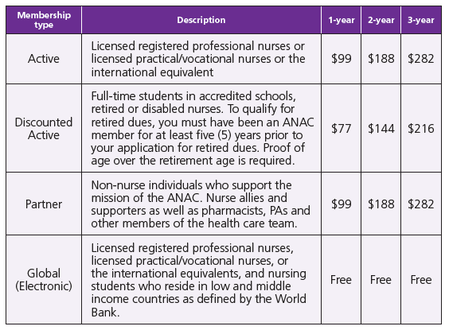

Slide 5
How to start a chapter
1- Contact the National Office for a list of all ANAC members in your area. All members of an ANAC local chapter must be members of ANAC National. If you have people who are interested in forming a chapter, but who are not members, then the Chapters Chair will assist you in encouraging interested parties to join the ANAC organization.
2- Set up an organization meeting to discuss:
The viability of starting a chapter
When to meet
Where to meet
Educational topics for meetings/strategic plan
Chapter leadership
Commitment to policies and procedures for ANAC Chapters

Slide 6
How to start a chapter
3. Plan, promote and hold first Chapter-in-Formation meeting. A commitment of 10 ANAC National members is needed to start a Chapter-in-Formation (CIF).
4. Complete the Chapter-in-Formation Declaration and submit to the Chapters Committee Chair.
5. Complete the Chapter Application
6. Recruit Members

Slide 7
How to run a Chapter
Visit nursesinaidscare.com to download:
How to run a chapter booklet
Chapter boards of directors roles and responsibilities
Sample letters (welcome, recruitment, renewal, scholarships)
Event template and instructions
ANAC logo package: Each chapter has been provided with a logo and logo use package. If you have questions about your chapter logo please contact the ANAC national office. The ANAC and ANAC chapter logos are not to be altered or changed in any way.

Slide 8
In case you want to add anything else.

